Slide 1
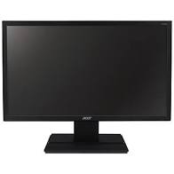
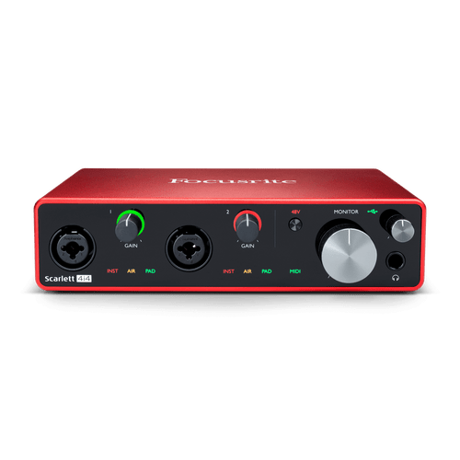
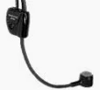
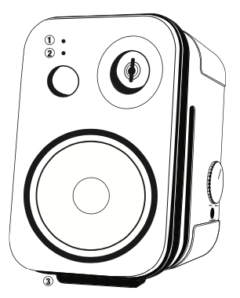
3.5mm touchproof extension
Respiration Sensor
Arm EMGs
ISOBOX
Sterile field
In 110V
EMG
Out 6
Lead connector
Out 5
Out 4
Out 3
Out 2
Out 1
ECoG+Stim 5
Monitor Power Cable
Nomad
Port D
ECoG+Stim 4
Cabrio 8
Port C
Cabrio 7
HDMI Cable
Monitor
Port B
ECoG+Stim 3
Octopus 2
Cabrio 6
ECoG Strip 2
O: power
A/D IO
Port A
Cabrio 5
ECoG+Stim 2
Cabrio 4
110V
Power source
Cabrio 3
Ethernet
ECoG+Stim 1
Octopus 1
Cabrio 2
DC power
source
Cabrio 1
ECoG Strip 1
Alienware
Digital I/O
3.5mm male-female stereo 3’
Out 1 & 2
USB C
Ethernet
Analog I/O
SMA out 1-3
SMA out 4
USB Hub
USB
3.5mm audio
SMA to BNC – BNC adaptor – BNC extension cable
BNC to XLR
In 3
In 2
In 1
USB
Radial USB
XLR female-male balanced cable 10’ (2x)
XLR
splitter
XLR female-male balanced cable 3’
Mouse
Keyboard
BNC to SMA
BNC Box
JBL 2P
Studio
Monitor
(Speaker)
DC power
source
BNC to SMA
Extension barrel DC power
Rotameter
BNC cable 3’
BNC cable 9’
Vibration Sensor
BNC cable 3’
Monitor Photodiode
Mini Display Port to Display Port
Monitor Power Cable
Sync signal Source
XLR to BNC
AlphaOmega
Stimulus Presentation
Monitor
BNC-T
BNC cable 20’
BNC to SMA
BNC cable 20’

Slide 2

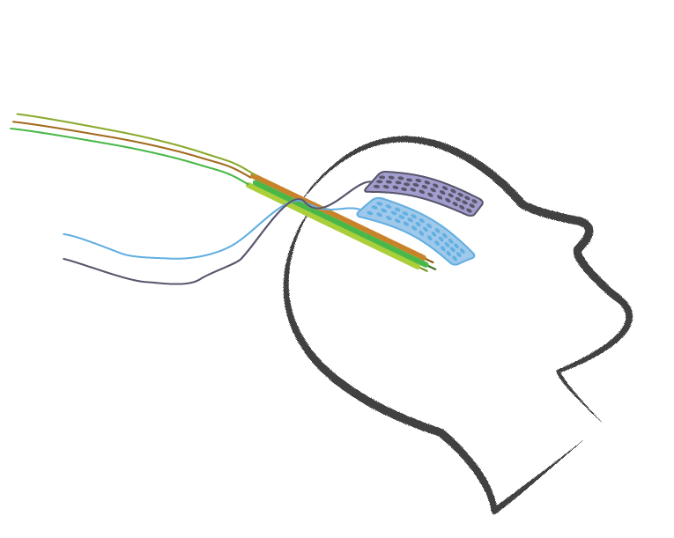
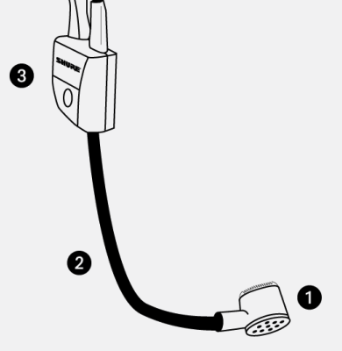
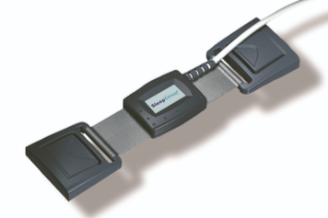
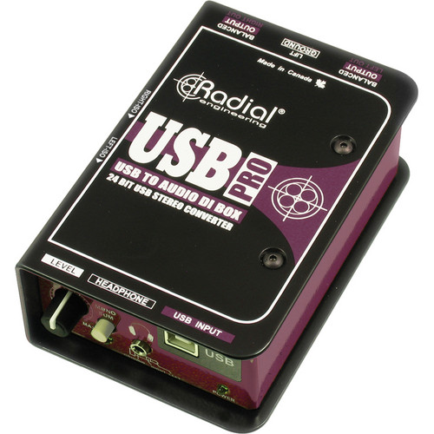
Intraoperative speech research setup – Sentence stimulation task
MGH
DBS - LFPs
Shure
WH20
ECoG
ECoG
EMG
Neural Data
Respiration
Analog
Nomad
Produced Audio
Photodiode
I/O
I/O
Digital
Stimulus presentation
Task Computer
Focusrite
Scarlett 4i4 4th Gen
Psychtoolbox

